Slide 1
Finding Sources

Slide 2
Scholarship is a conversation
What do you think this means?
When we say “Scholarship is a conversation” we are saying, in part, that there is dialog between scholars where the research publication represents the dialog.
Scholars conduct their research, publish their findings and expect/anticipate that other scholars will then engage with their research by responding, critiquing, and rebutting with new research.
There is a back & forth and continual exchange taking place, as new knowledge is created!!

Slide 3
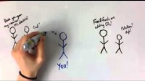

Slide 4
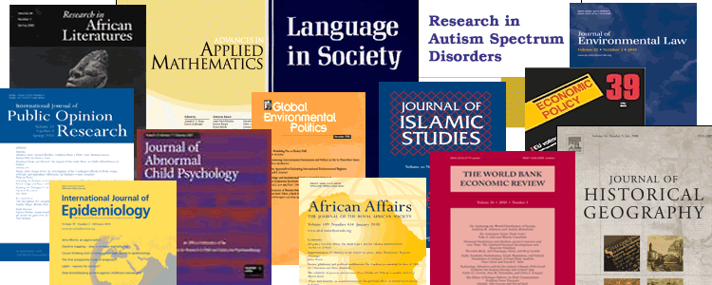
Books, book chapters, journal articles, conference presentations and papers, dissertations…
Where are the scholarly conversations happening?
(The formal process of finding out “who the players are” around a particular research question is called conducting a literature review. You will conduct many lit reviews before you graduate!)
…and open sources on the internet, social media, videos, podcasts, etc.
There are now many more and varied ways for scholars to publish and present their research, and for researchers to find the scholarship.
Faculty Scholarship Reception

Slide 5
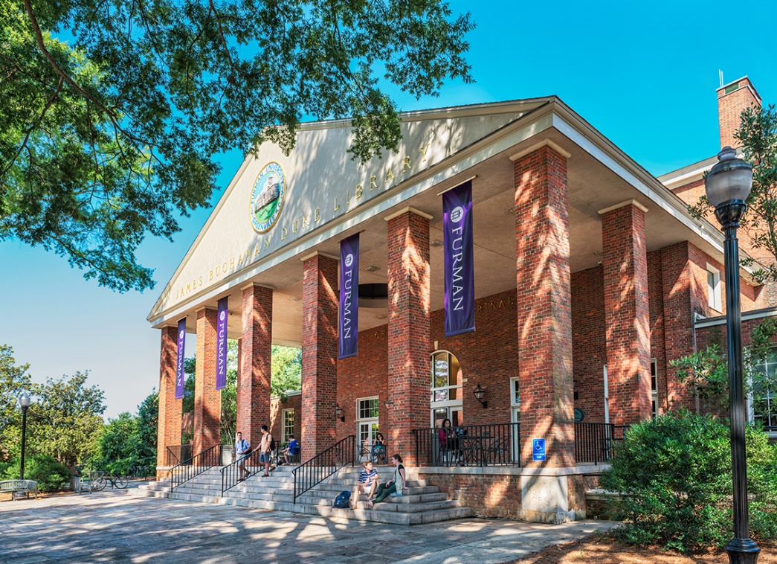
How do you find Journal Articles?
Library databases are your best bet!
When you start with the databases you are firmly in the spaces where the scholarly conversations are taking place.
You have pass-through access to the articles that are often behind pay walls since the library has subscriptions to the content (600+ databases).
You have features like “Limit to peer reviewed”

Slide 6
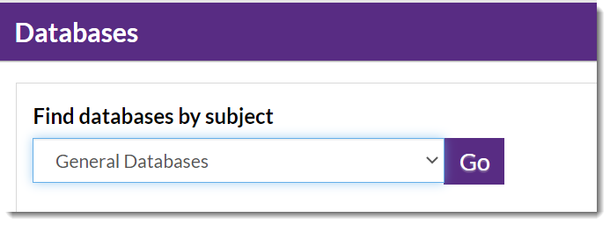
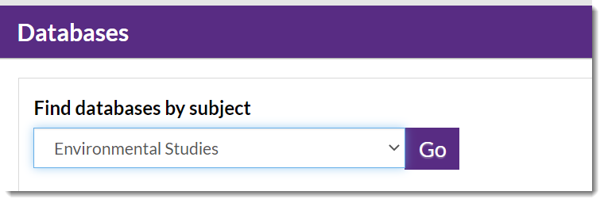
Library Databases:
General and Subject Specific
From the library homepage, you have options to select databases by subject area. Keep in mind some databases cover many subject areas, they are broad and multidisciplinary, like ACADEMIC Search premier.
Others are very targeted to specific subjects. You can discover the appropriate database by selecting the subject area.

Slide 7
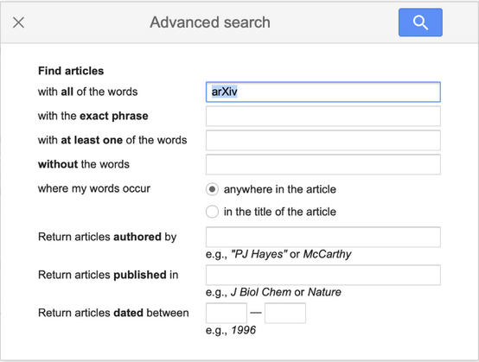
What about Google Scholar?
This is why it’s cool:
It covers conference proceedings, preprints, and peer-reviewed journals.
Specific keywords (e.g., business, logistics, etc.) can be added to specify domains.
Lists the number of times an article has been cited by other researchers (keep in mind newer work = fewer citations)
Has some good “Advanced Search” options

Slide 8
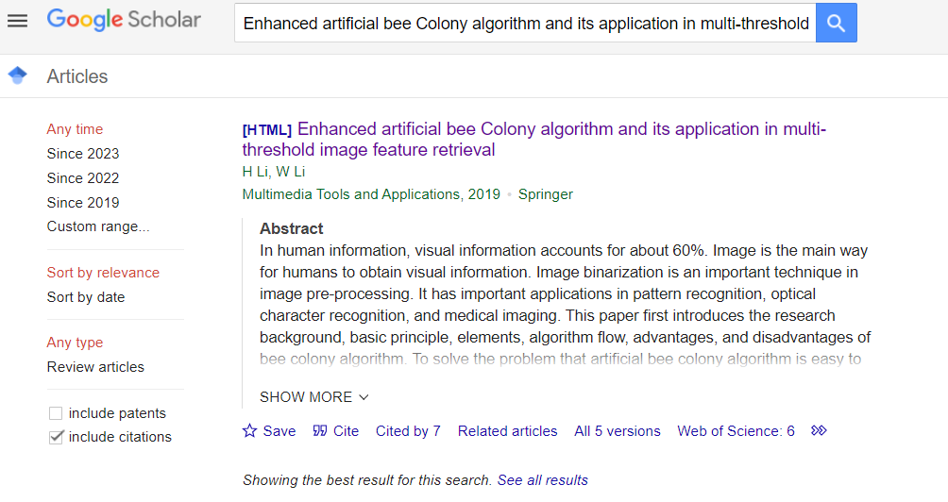
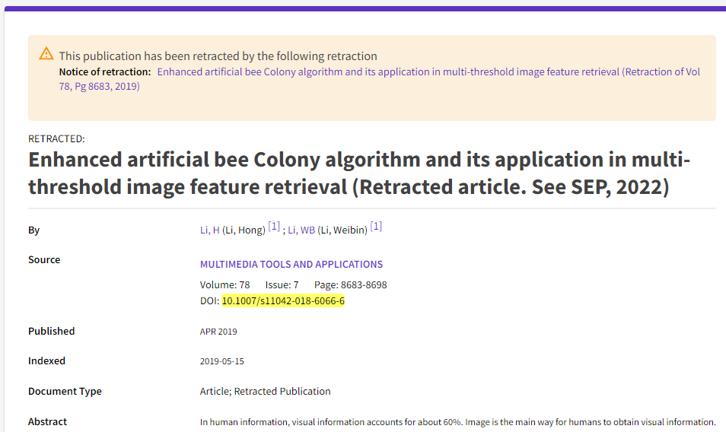
What about Google Scholar?
This is why it’s NOT cool:
Students frequently encounter ‘paywalls’; this can be bypassed (sometimes) by syncing with Furman library in ‘settings’
Many scholars feel there are ethical concerns surrounding the algorithms of placement. Can you pay Google to have your article appear first in the list?
Because it’s ‘free’, Google has no incentive to inform you about retracted research. This could be terribly embarrassing for you!

Slide 9
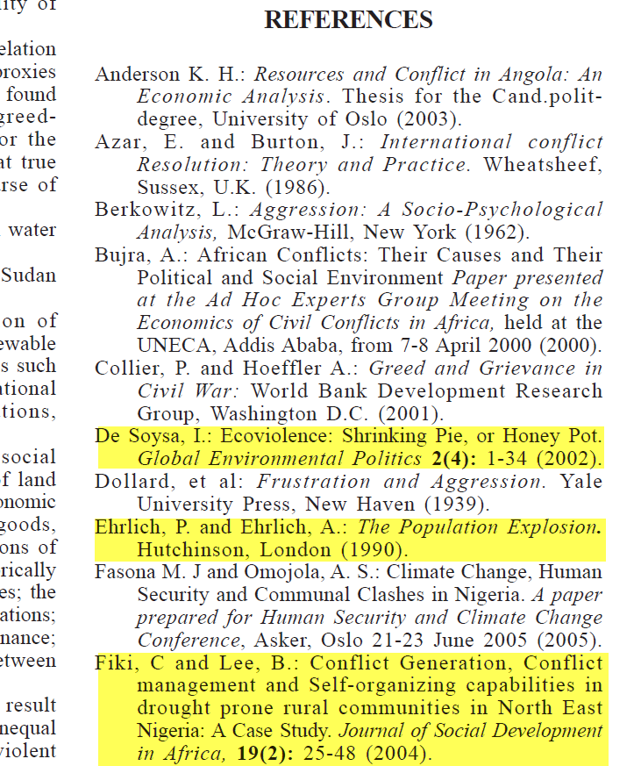
Research Tip…
One of the most useful skills you can develop is citation tracking OR citation chaining – the ability to find other relevant or related sources based on a bibliography.
If you find a pertinent article or book, reviewing the bibliography is an effective way to broaden your search, so always look at the bibliography.

Slide 10
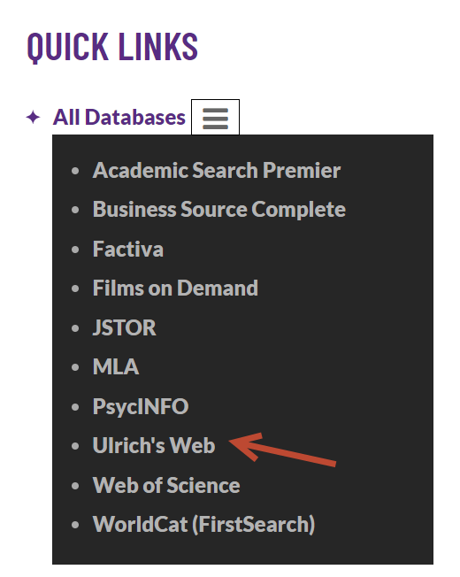
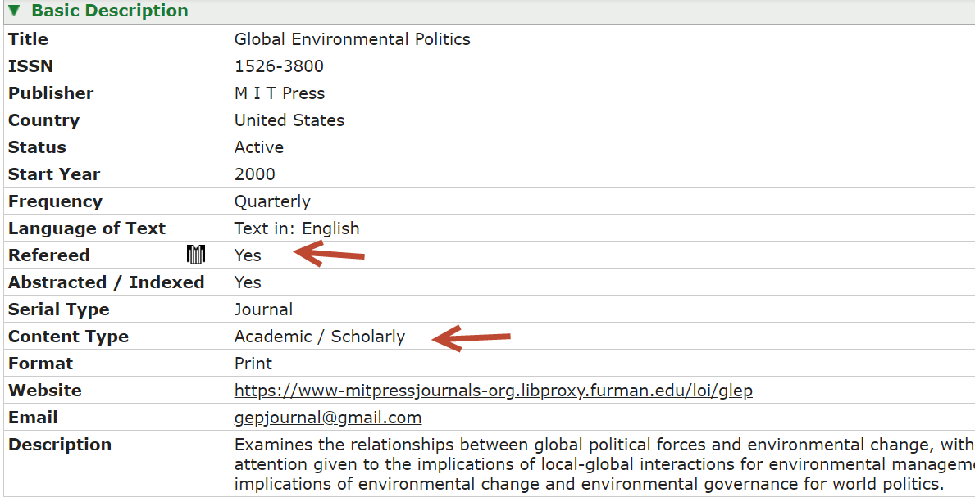
Is Global Environmental Politics a scholarly publication? Look in Ulrich’s web

Slide 11
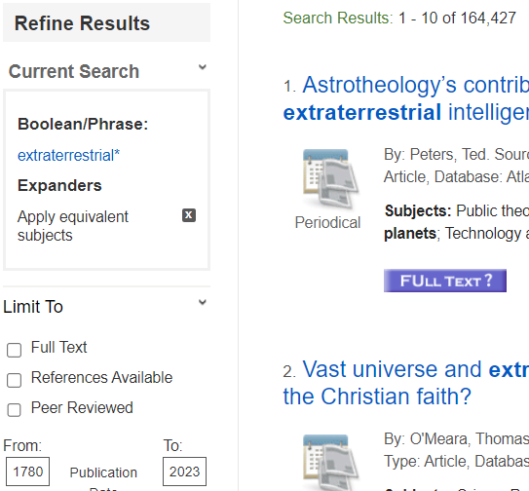
Has your article been peer reviewed?
Use a Database Limiter

Slide 12
Citations are CRUCIAL
"Citing" means giving credit to the original ideas of others through proper attribution.
As creators and users of information, there are certain rights and responsibilities associated with participating in a community of scholarship.
Proper citation = avoiding plagiarism and not violating copyright law

Slide 13
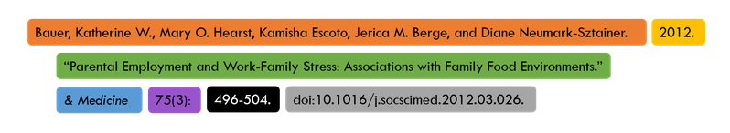
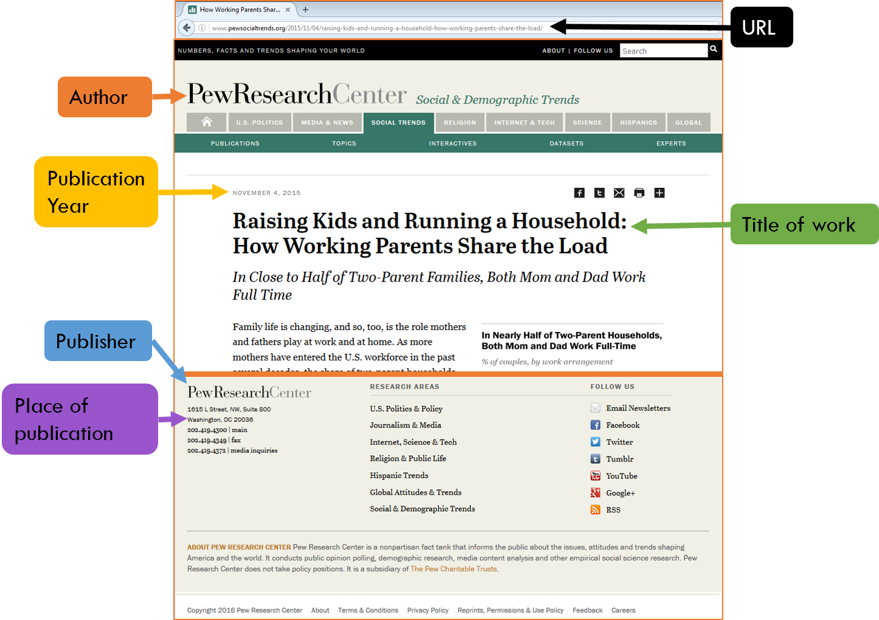
What does DOI stand for?
What are some common citation styles?

Slide 14
Now Let’s Look at Your Course Guide…

